Slide 1
Natural Language Learning
LSTM

Slide 2
Introduction
Deep Learning
Recurrent Neural Network
Long Short-Term Memory
Natural Language Learning

Slide 3
Introduction
*Deep learning is a specific subfield of machine learning.
*Deep learning extract pattern from raw data.
*Deep learning is being used in areas of artificial intelligence as computer vision,NLP and RL.
*DL has a lot of models but the one we focused on is Recurrent Neural Network abbreviated as RNN
Understanding deep learning for LSTM.

Slide 4
Introduction
*RNN works well with sequence classification
*Essential to RNN is the LSTM
*LSTM was used for sequence classification because of its remarkable performance in sentence modelling.
*DL is also used for NLP and NLP was used for text classification on our datasets
Understanding deep learning for LSTM.

Slide 5
The Problem
IMDB
PubMed DataSet

Slide 6
The Data
IMDB Data
PubMed Data
Data Preparation

Slide 7
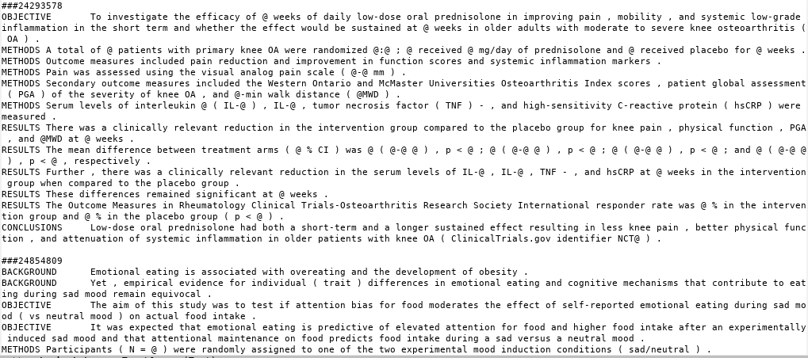
Actual data set example from train.txt

Slide 8
Mistakes
Dictionary
Loss Function
Other Hyperparameters
Transitioning the IMDB Keras code to work with PubMed dataset

Slide 9
Results
Capturing the results
Chosen Hyperparameters

Slide 10
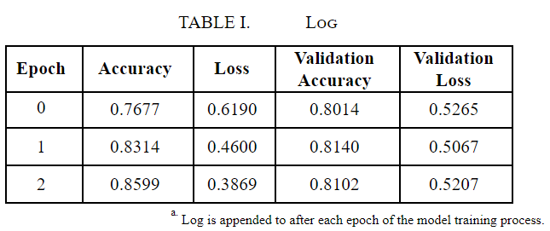

Slide 11
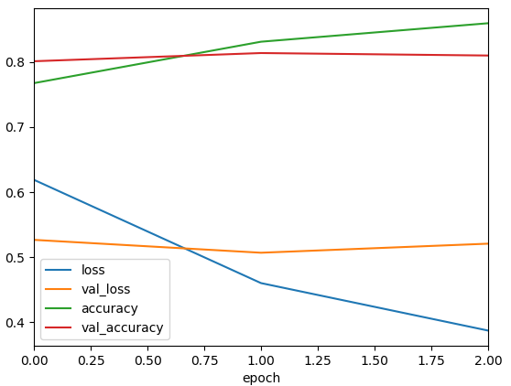

Slide 12
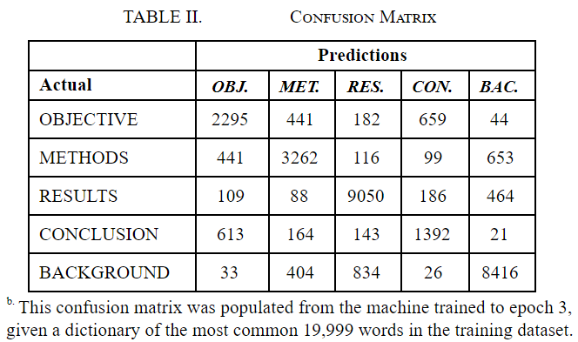

Slide 13
References
Chollet François, & Chollet François. (2018). 6. In Deep learning with Python (pp. 178–232). Shelter Island, NY: Manning Publications Co.
Koenig, R. (2019, July 29). NLP for Beginners: Cleaning & Preprocessing Text Data. Retrieved from https://towardsdatascience.com/nlp-for-beginners-cleaning-preprocessing-text-data-ae8e306bef0f.
Keras: The Python Deep Learning library. (n.d.). Retrieved from https://keras.io/.
Keras-Team. (2019, November 6). keras-team/keras. Retrieved from https://github.com/keras-team/keras.

Slide 14
Additional data:
With the labels as word encodings:
sigmoid activation:
[[ 0 66 30 27 2540]
[ 0 350 21 21 4034]
[ 0 76 44 31 9600]
[ 0 38 13 63 2263]
[ 0 139 23 17 10097]]
.80 accuracy according to the binary_crossentropy loss function, .3578 actual accuracy
softmax activation:
[[ 0 66 2569 28 0]
[ 0 350 4053 23 0]
[ 0 76 9644 31 0]
[ 0 38 2276 63 0]
[ 0 139 10119 18 0]]
.80 accuracy according to the binary_crossentropy loss function, .341 actual accuracy

Slide 15
Correct code, but only using the 10 most common words:
[[ 504 838 666 239 416]
[ 424 1696 1085 171 1050]
[ 601 516 6121 84 2429]
[ 172 442 424 1137 202]
[ 324 840 2875 69 6168]]
.5298 validation accuracy

